Slide 1
Parallel and Distributed Computing
Chapter 1: Introduction to Parallel Computing
Lecture 1
1

Slide 2
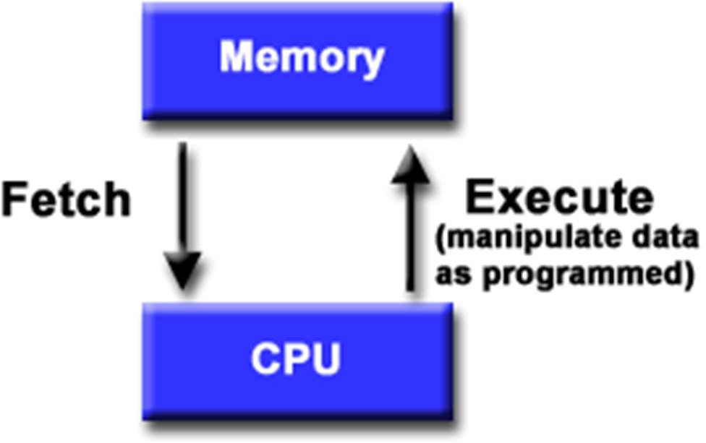
1.1a: von Neumann Architecture
Common machine model for over 70 years
Stored-program concept
CPU executes a stored program
A sequence of read and write operations on the memory
Order of operations is sequential
2

Slide 3
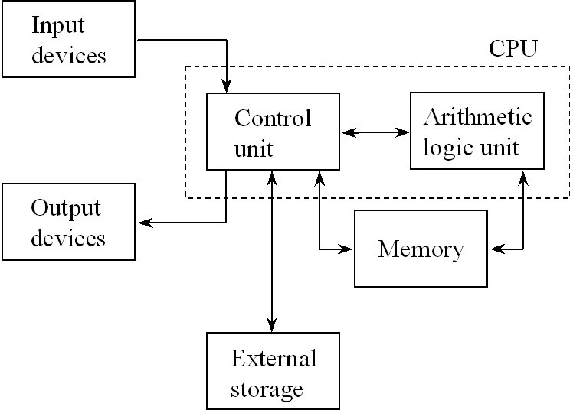
1.1b: A More Detailed Architecture based on von Neumann Model
3

Slide 4
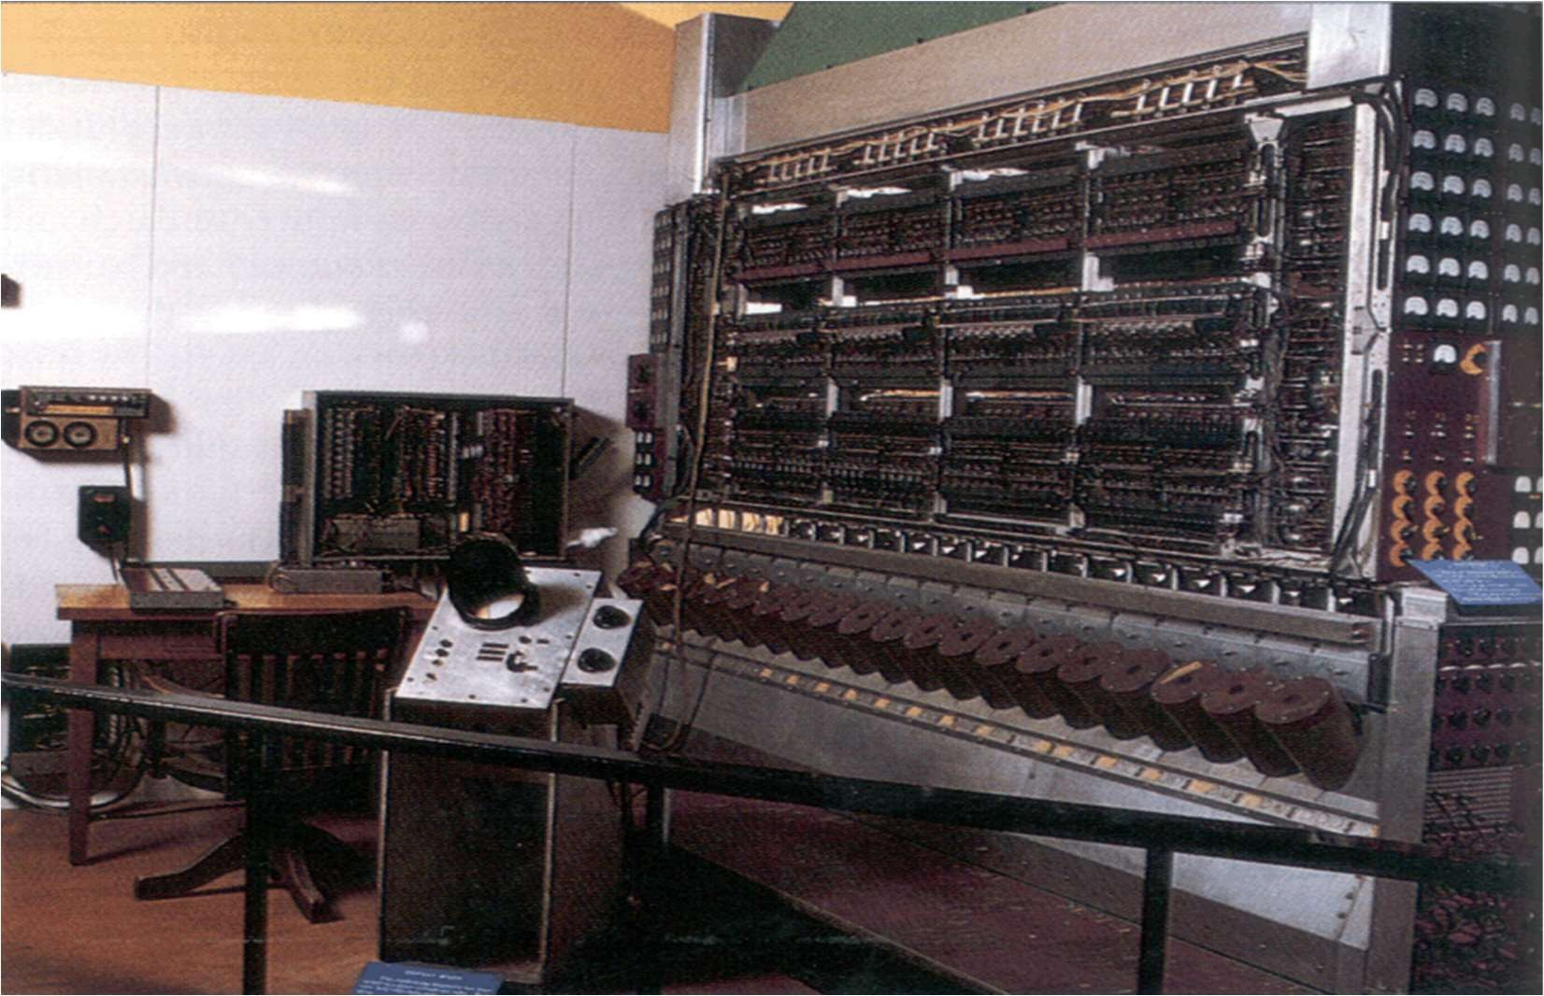
1.1c: Old von Neumann Computer
4

Slide 5
1.1d: CISC von Neumann Computer
CISC stands for Complex Instruction Set Computer with a single bus system
Harvard (RISC) architecture utilizes two buses, a separate data bus and an address bus
RISC stands for Reduced Instruction Set Computer
They are SISD machines – Single Instruction Stream on Single Data Stream
We will also discuss SIMD, MISD, MIMD
5

Slide 6
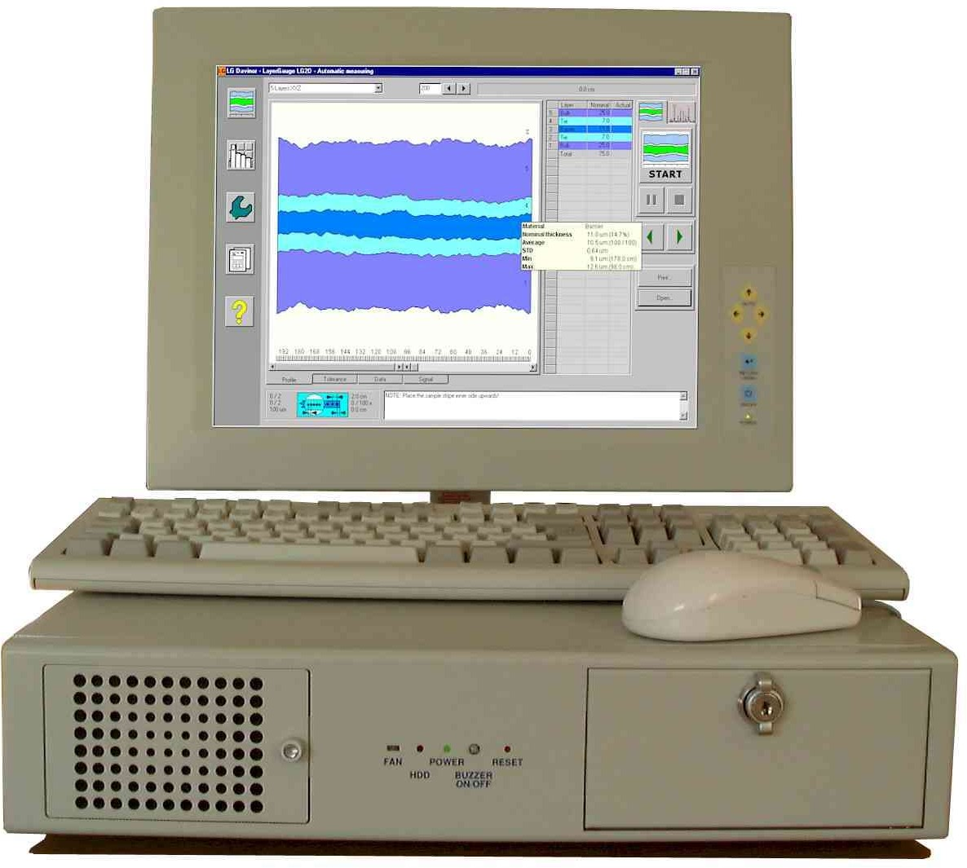
1.1e: Personal Computer
6

Slide 7
1.2a: Motivations for Parallel Computing
Fundamental limits on single processor speed
Heat dissipation from CPU chips
Disparity between CPU & memory speeds
Distributed data communications
Need for very large scale computing platforms
7

Slide 8
1.2b: Fundamental Limits – Cycle Speed
Intel 8080
ARM 2
Intel Pentium Pro
AMD Athlon
Intel QX6700
Intel Core i7 3770k
2MHz
8MHz
200MHz
1.2GHz
2.66GHz
3.9GHz
1974
1986
1996
2000
2006
2013
Speed of light: 30cm in 1ns
Signal travels about 10 times slower
8

Slide 9
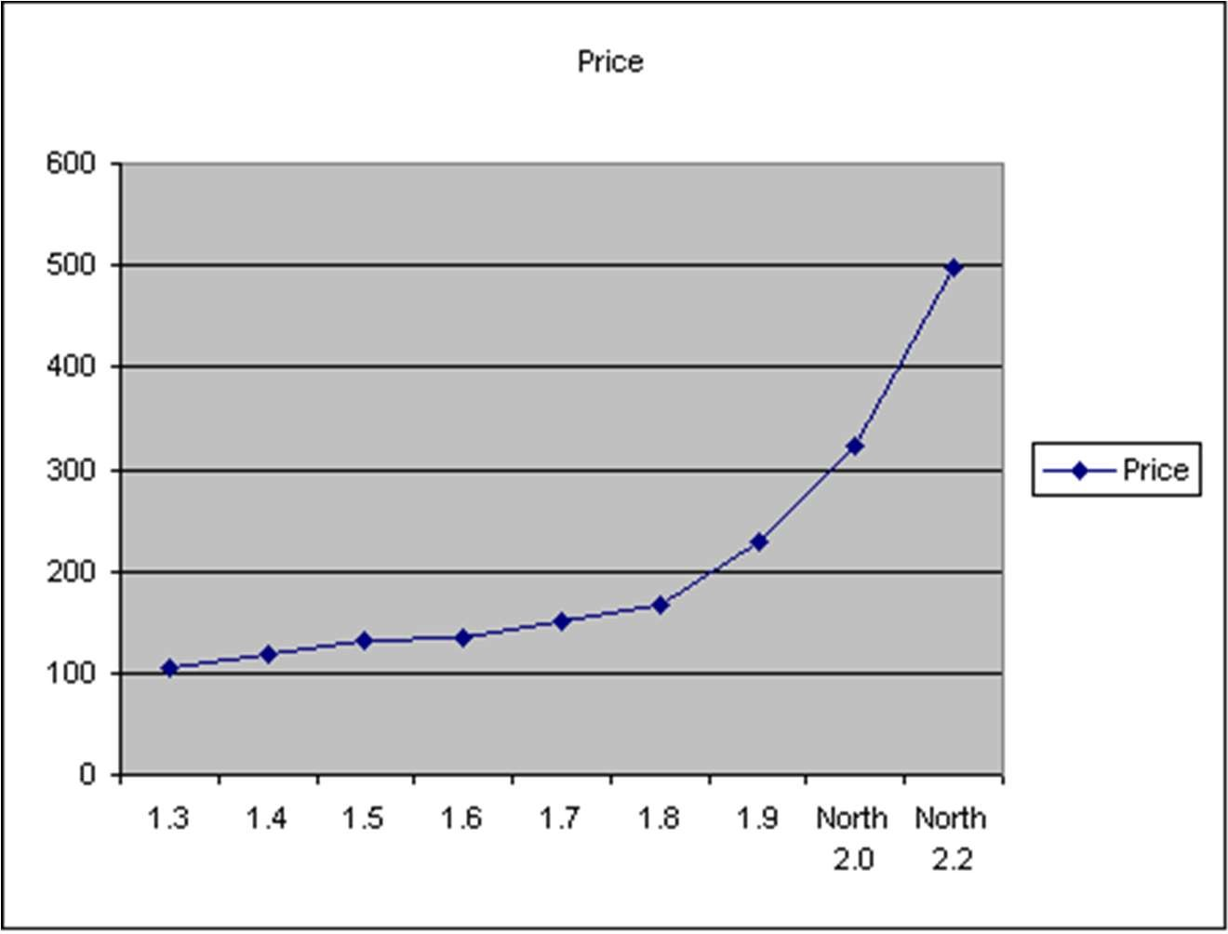
1.2c: High-End CPU is Expensive
Price for high-end CPU rises sharply
Intel processor price/performance
*.*
10

Slide 10
1.2d: Moore’s Law
Moore’s observation in 1965: the number of transistors per square inch on integrated circuits had doubled every year since the integrated circuit was invented
Moore’s revised observation in 1975: the pace was slowed down a bit, but data density had doubled approximately every 18 months
How about the future? (price of computing power falls by a half every 18 months?)

Slide 11
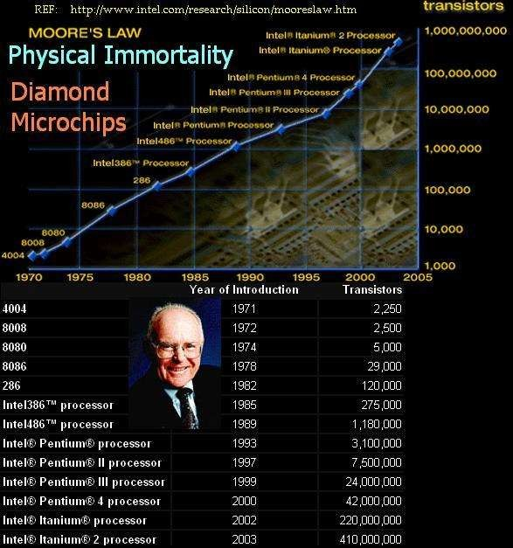
1.2e: Moore’s Law – Held for Now

Slide 12
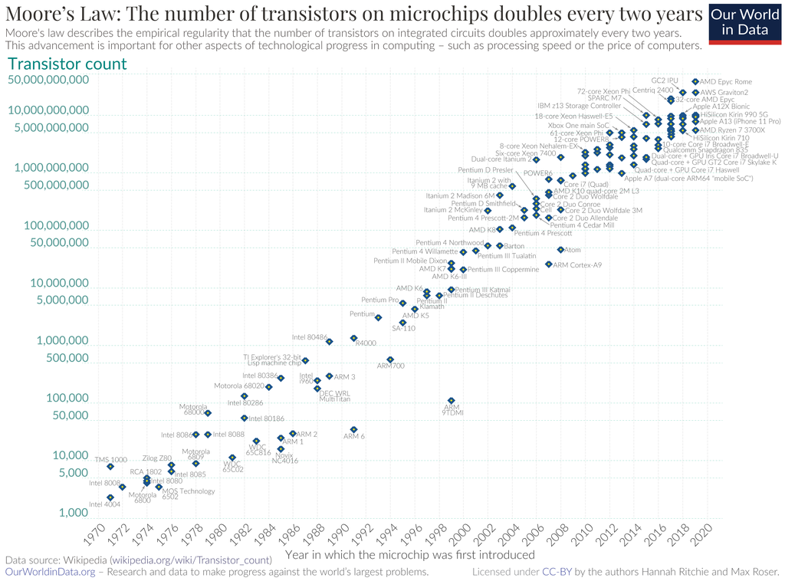

Slide 13
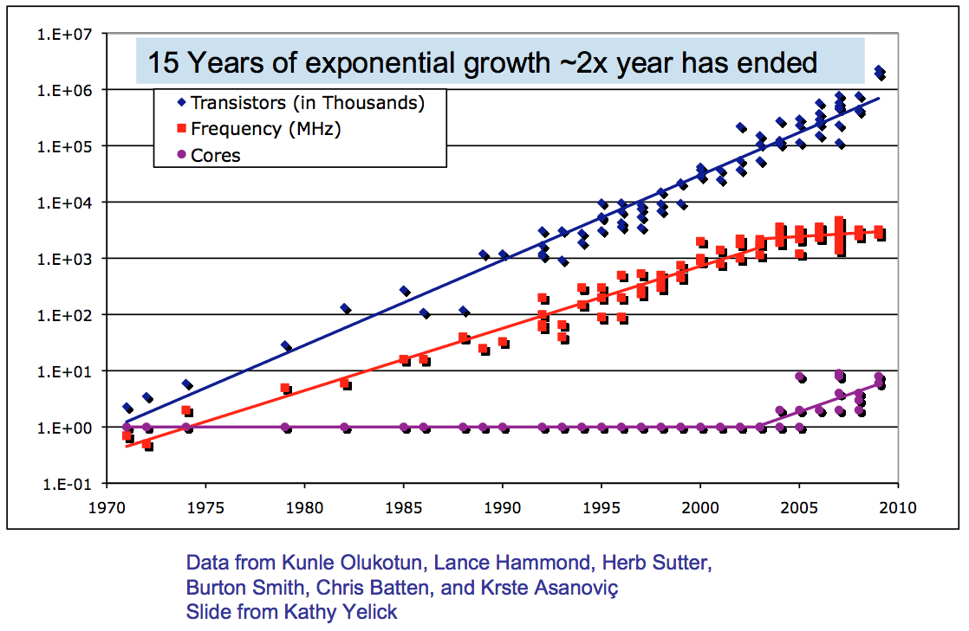
What’s Driving Parallel Computing Architecture?

Slide 14
Uniprocessor Performance (SPECint) Today
3X
From Hennessy and Patterson, Computer Architecture: A Quantitative Approach, 4th edition, 2006
2x every 5 years?
⇒ Sea change in chip design: multiple “cores” or processors per chip
VAX : 25%/year 1978 to 1986
RISC + x86: 52%/year 1986 to 2002
RISC + x86: ??%/year 2002 to present

Slide 15
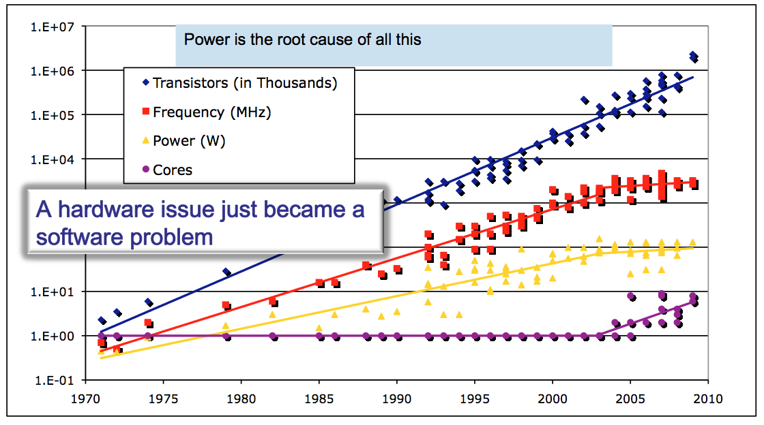
What’s Driving Parallel Computing Architecture?
power wall

Slide 16
1.3: Power Wall Effect in Computer Architecture
Too many transistors in a given chip die area
Tremendous increase in power density
Increased chip temperature
High temperature slows down the transistor switching rate and the overall speed of the computer
Chip may melt down if not cooled properly
Efficient cooling systems are expensive

Slide 17
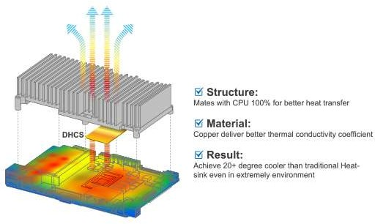
1.3: Cooling Computer Chips
Some people suggest to put computer chips in liquid nitrogen to cool them

Slide 18
Parallelism Saves Power
Exploit explicit parallelism for reducing power
Power = 2C * V²/4 * F/2 Performance = 2Cores * F/2
Power = (C * V² * F)/4 Performance = (Cores * F)*1
Power = C * V² * F Performance = Cores * F
Capacitance Voltage Frequency
Power = 2C * V² * F Performance = 2Cores * F
Using additional cores
Increase density (= more transistors = more capacitance)
Can increase cores (2x) and performance (2x)
Or increase cores (2x), but decrease frequency (1/2): same performance at ¼ the power
Additional benefits
Small/simple cores → more predictable performance

Slide 19
Moore’s 2nd Law: Chip Yield
Manufacturing costs and yield problems limit use of density
Moore’s (Rock’s) 2nd law: fabrication costs go up
Yield (% usable chips) drops
Parallelism can help
More smaller, simpler processors are easier to design and validate
Can use partially working chips:
E.g., Cell processor (PS3) is sold with 7 out of 8 “on” to improve yield
Notes:
Rock’s Law = cost doubles every 4 years
.06 micron = 600 Angstroms
Currently (2006?) gate oxide insualator in transistor about 5 atoms thick

Slide 20
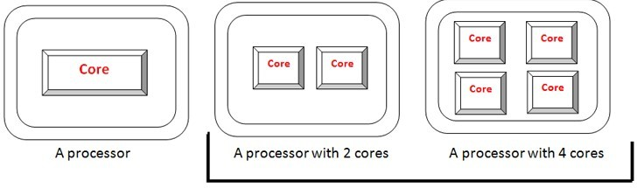
1.3: Solutions
Use multiple inexpensive processors A processor with multiple cores

Slide 21
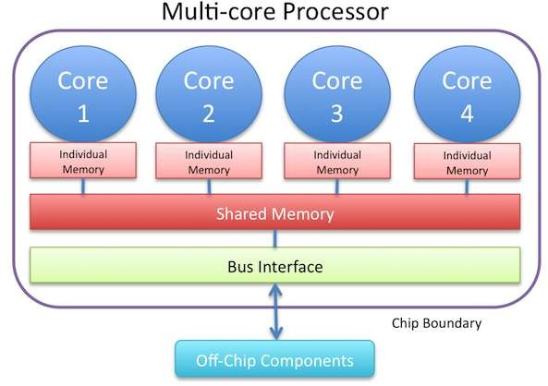
1.3: A Multi-core Processor

Slide 22
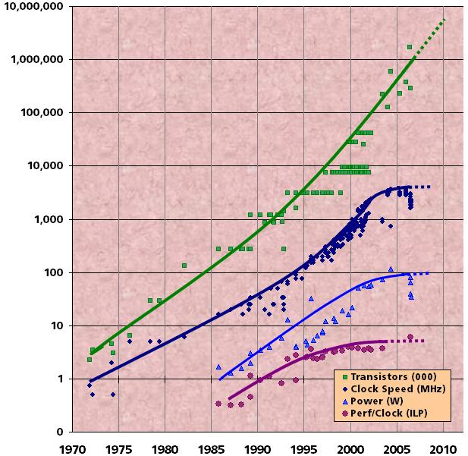
Revolution is Happening Now
Chip density is continuing increase ~2x every 2 years
Clock speed is not
Number of processor cores may double instead
There is little or no hidden parallelism (ILP) to be found
Remember:
Power = (C * V² * F)/4
Performance = (Cores * F)*1
Source: Intel, Microsoft (Sutter) and Stanford (Olukotun, Hammond)

Slide 23
1.3a: CPU and Memory Speeds
In 20 years, CPU speed (clock rate) has increased by a factor of 1000
DRAM speed has increased only by a factor of smaller than 4
How to feed data faster enough to keep CPU busy?
CPU speed: 1-2 ns
DRAM speed: 50-60 ns
Cache: 10 ns

Slide 24
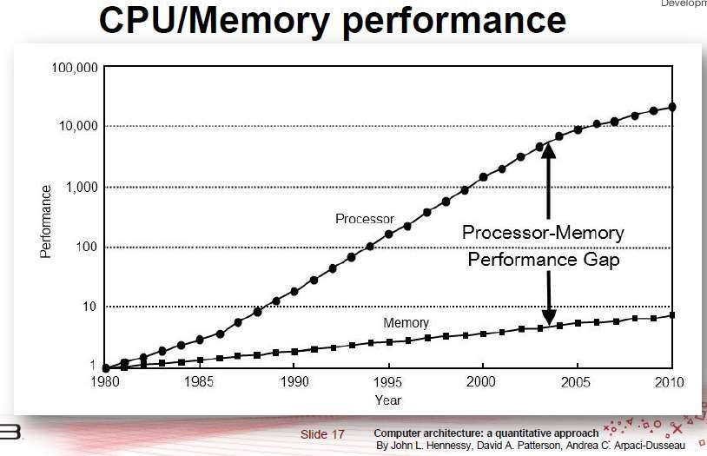
1.3b: Memory Access and CPU Speed

Slide 25
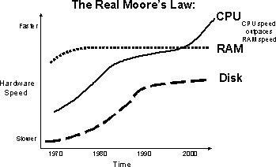
1.3b: CPU, Memory, and Disk Speed

Slide 26
1.3c: Possible Solutions
A hierarchy of successively fast memory devices (multilevel caches)
Location of data reference (code)
Efficient programming can be an issue
Parallel systems may provide 1.) larger aggregate cache
2.) higher aggregate bandwidth to the memory system
20

Slide 27
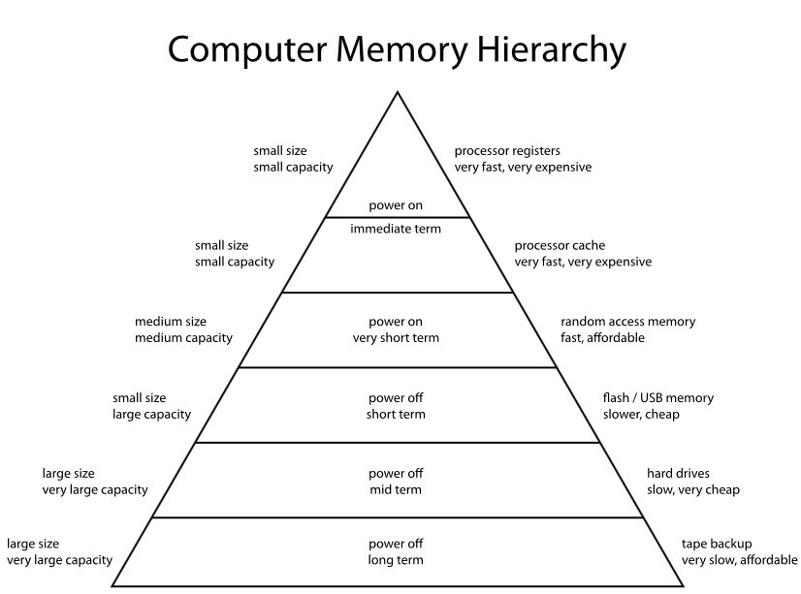
1.3f: Multilevel Hierarchical Cache

Slide 28
1.4: Distributed Data Communications
Data may be collected and stored at different locations
It is expensive to bring them to a central location for processing
Many computing assignments may be inherently parallel
Privacy issues in data mining and other large scale commercial database manipulations

Slide 29
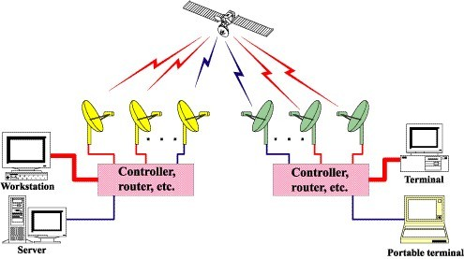
Distributed Data Communications

Slide 30
Paradigm Shift
Performance is the main issue
Hardware problem became software problem
Let’s look at some computation problems to understand how critical is this performance issue.

Slide 31
Computational Science
Traditional scientific methodology
Theoretical science
Formal systems and theoretical models
Insight through abstraction, reasoning through proofs
Experimental science
Real system and empirical models
Insight from observation, reasoning from experiment design
Computational science
Emerging as a principal means of scientific research
Use of computational methods to model scientific problems
Numerical analysis plus simulation methods
Computer science tools
Study and application of these solution techniques

Slide 32
Need for Large Scale Modeling
Long term weather forecasting
Large scale ocean modeling
Oil reservoir simulations
Car and airplane manufacturing
Semiconductor simulation
Pollution tracking
Large scale commercial databases
Aerospace (NASA microgravity modeling)

Slide 33
Semiconductor Simulation
Before 1975, an engineer had to make several runs through the fabrication line until a successful device was fabricated
Device dimensions shrink below 0.1 micro-meter
A fabrication line costs 1.0 billion dollars to build
A design must be thoroughly verified before it is committed to silicon
A realistic simulation for one diffusion process may take days or months to run on a workstation
Chip price drops quickly after entering the market

Slide 34
Drug Design
Most drugs work by binding to a specific site, called a receptor, on a protein
A central problem is to find molecules (ligands) with high binding affinity
Need to accurately and efficiently estimate electrostatic forces in molecular and atomic interactions
Calculate drug-protein binding energies from quantum mechanics, statistical mechanics and simulation techniques
31

Slide 35
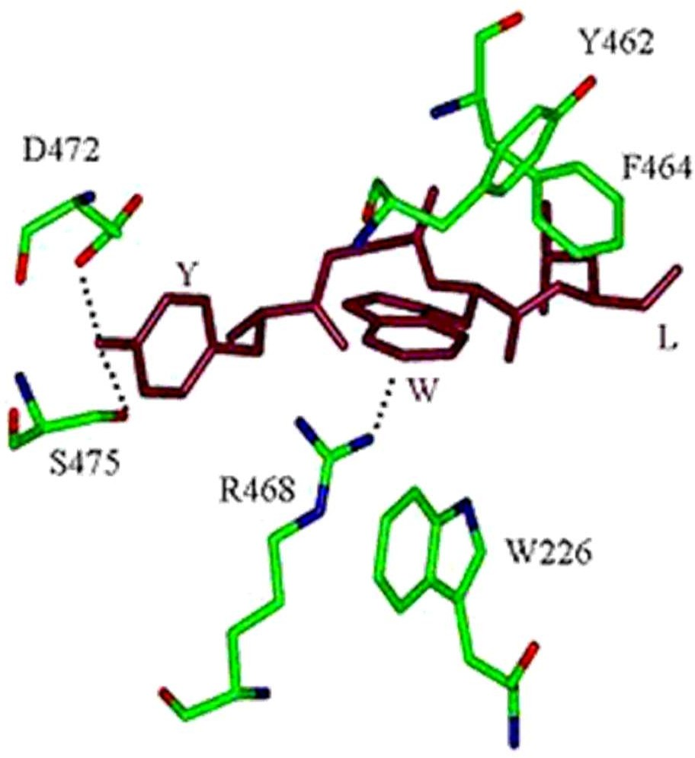
Computing Protein Binding
32

Slide 36
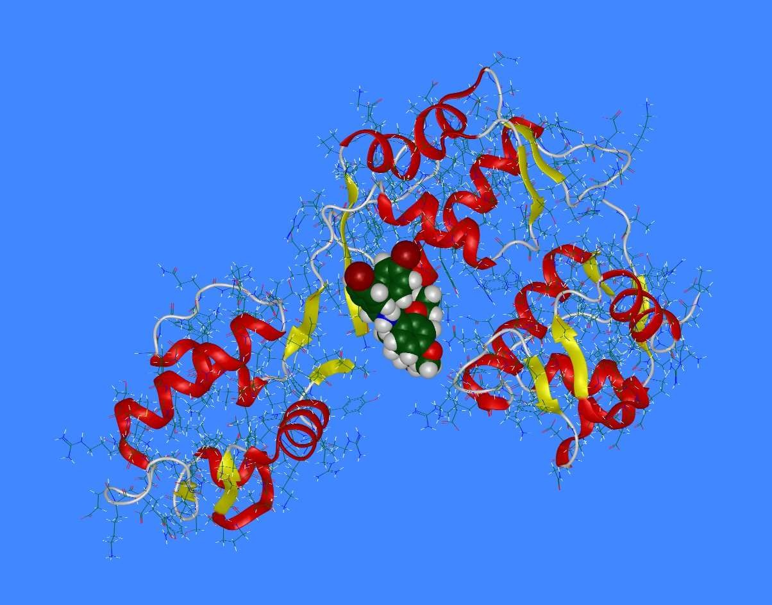
Computer Aided Drug Design
33

Slide 37
Issues in Computational science
Computational science thrives on computer power
Faster solutions
Finer resolution
Bigger problems
Improved interaction
Fault-resilient Solution
BETTER SCIENCE!!!
How to get more computer power?
Scalable parallel computing

Slide 38
Parallel Processing – What is it?
A parallel computer is a computer system that uses multiple processing elements simultaneously in a cooperative manner to solve a computational problem
Parallel processing includes techniques and technologies that make it possible to compute in parallel
Hardware, networks, operating systems, parallel libraries, languages, compilers, algorithms, tools, …
Parallel computing is an evolution of serial computing
Parallelism is natural
Computing problems differ in level / type of parallelism
Parallelism is all about performance! Really?

Slide 39
Concurrency
Consider multiple tasks to be executed in a computer
Tasks are concurrent with respect to each if
They can execute at the same time (concurrent execution)
Implies that there are no dependencies between the tasks
Dependencies
If a task requires results produced by other tasks in order to execute correctly, the task’s execution is dependent
If two tasks are dependent, they are not concurrent
Some form of synchronization must be used to enforce (satisfy) dependencies
Concurrency is fundamental to computer science
Operating systems, databases, networking, …

Slide 40
Concurrency and Parallelism
Concurrent is not the same as parallel! Why?
Parallel execution
Concurrent tasks actually execute at the same time
Multiple (processing) resources have to be available
Parallelism = concurrency + “parallel” hardware
Both are required
Find concurrent execution opportunities
Develop application to execute in parallel
Run application on parallel hardware
Is a parallel application a concurrent application?
Is a parallel application run with one processor parallel? Why or why not?

Slide 41
Parallelism
There are granularities of parallelism (parallel execution) in programs
Processes, threads, routines, statements, instructions, …
Think about what are the software elements that execute concurrently
These must be supported by hardware resources
Processors, cores, … (execution of instructions)
Memory, DMA, networks, … (other associated operations)
All aspects of computer architecture offer opportunities for parallel hardware execution
Concurrency is a necessary condition for parallelism
Where can you find concurrency?
How is concurrency expressed to exploit parallel systems?

Slide 42
Why use parallel processing?
Two primary reasons (both performance related)
Faster time to solution (response time)
Solve bigger computing problems (in same time)
Other factors motivate parallel processing
Effective use of machine resources
Cost efficiencies
Overcoming memory constraints
Serial machines have inherent limitations
Processor speed, memory bottlenecks, …
Parallelism has become the future of computing
Performance is still the driving concern
Parallelism = concurrency + parallel HW + performance

Slide 43
Perspectives on Parallel Processing
Parallel computer architecture
Hardware needed for parallel execution?
Computer system design
(Parallel) Operating system
How to manage systems aspects in a parallel computer
Parallel programming
Libraries (low-level, high-level)
Languages
Software development environments
Parallel algorithms
Parallel performance evaluation
Parallel tools
Performance, analytics, visualization, …

Slide 44
Why study parallel computing today?
Computing architecture
Innovations often drive to novel programming models
Technological convergence
The “killer micro” is ubiquitous
Laptops and supercomputers are fundamentally similar!
Trends cause diverse approaches to converge
Technological trends make parallel computing inevitable
Multi-core processors are here to stay!
Practically every computing system is operating in parallel
Understand fundamental principles and design tradeoffs
Programming, systems support, communication, memory, …
Performance
Parallelism is the future of computing

Slide 45
Inevitability of Parallel Computing
Application demands
Insatiable need for computing cycles
Technology trends
Processor and memory
Architecture trends
Economics
Current trends:
Today’s microprocessors have multiprocessor support
Servers and workstations available as multiprocessors
Tomorrow’s microprocessors are multiprocessors
Multi-core is here to stay and #cores/processor is growing
Accelerators (GPUs, gaming systems)

Slide 46
Application Characteristics
Application performance demands hardware advances
Hardware advances generate new applications
New applications have greater performance demands
Exponential increase in microprocessor performance
Innovations in parallel architecture and integration
Range of performance requirements
System performance must also improve as a whole
Performance requirements require computer engineering
Costs addressed through technology advancements
performance
applications
hardware

Slide 47
Broad Parallel Architecture Issues
Resource allocation
How many processing elements?
How powerful are the elements?
How much memory?
Data access, communication, and synchronization
How do the elements cooperate and communicate?
How are data transmitted between processors?
What are the abstractions and primitives for cooperation?
Performance and scalability
How does it all translate into performance?
How does it scale?

Slide 48
Scalable Parallel Computing
Scalability in parallel architecture
Processor numbers
Memory architecture
Interconnection network
Avoid critical architecture bottlenecks
Scalability in computational problem
Problem size
Computational algorithms
Computation to memory access ratio
Computation to communication ration
Parallel programming models and tools
Performance scalability
Scalability in Distributed Computing

Slide 49
Distributed Systems
Definition:
A Set of nodes, connected by a network, which appear to its users as a single coherent system.
Examples
Internet (interconnection of globally distributed computers)
WWW ( Interlinked hypertext)
Mobile network (interconnection of globally distributed computers and mobiles devices)

Slide 50
Benefits of Distributed Systems
Resource sharing
Load Sharing
Improves scalability
Improves reliability
Geographically distributed
Works during partial failure
Parallel processing, so performance improved
PASS, dev by IBM in 1981 used in space shuttle.
Could have been done by 1 m/c
IBM did with 4 nodes for fault tolerance

Slide 51
DS categories
Clusters
A computer cluster consists of a set of loosely or tightly connected computers that work together so that, in many respects, they can be viewed as a single system. Here, computer clusters have each node set to perform the same task ( homogeneous) , controlled and scheduled by software
Cloud
Internet-based computing, where different services — such as servers, storage and applications are delivered to an organization's computers and devices through the Internet.
Grid
Grid computing is the collection of computer resources from multiple locations to reach a common goal.
The grid can be thought of as a distributed system with non-interactive workloads that involve a large number of files.
Grid computing is distinguished from conventional high performance computing systems such as clusters in that grid computers have each node set to perform a different task/application.

Slide 52
Distributed computing
Clusters
Multiple computers connected together e.g LAN
Each node performs same task
Controlled by network software
Mostly physically coupled
Cloud
Multiple computers connected together through Internet
All hardware and software services provided by cloud provider without any knowledge to customers, You lease anything you want and pay for that only
Grid
Multiple computers from different locations connected together each perform different tasks and achieves ONE common goal
Not physically coupled
Order of increasing complexity

Slide 53
Centralised Vs Distributed Computing
Centralised | Distributed
Many jobs done on a single CPU | Jobs are distributed to many CPUs which are interconnected
Uses Shared memory, Variables concept | NO Shared memory, Variables concept
Single global clock to sync ops | No global clock

Slide 54
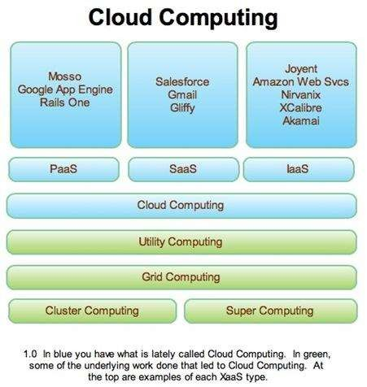

Slide 55
Why writing (fast) parallel programs is hard

Slide 56
Principles of Parallel Computing
Finding enough parallelism (Amdahl’s Law)
Granularity
Locality
Load balance
Coordination and synchronization
Performance modeling
All of these things makes parallel programming even harder than sequential programming.

Slide 57
Finding Enough Parallelism
Suppose only part of an application seems parallel
Amdahl’s law
let s be the fraction of work done sequentially, so (1-s) is fraction parallelizable
P = number of processors
Speedup(P) = Time(1)/Time(P)
<= 1/(s + (1-s)/P)
<= 1/s
Even if the parallel part speeds up perfectly performance is limited by the sequential part

Slide 58
Overhead of Parallelism
Given enough parallel work, this is the biggest barrier to getting desired speedup
Parallelism overheads include:
cost of starting a thread or process
cost of communicating shared data
cost of synchronizing
extra (redundant) computation
Each of these can be in the range of milliseconds (=millions of flops) on some systems
Tradeoff: Algorithm needs sufficiently large units of work to run fast in parallel (I.e. large granularity), but not so large that there is not enough parallel work

Slide 59
Locality and Parallelism
Conventional
Storage
Hierarchy
Proc
Proc
Proc
Cache
Cache
Cache
L2 Cache
L2 Cache
L2 Cache
L3 Cache
L3 Cache
L3 Cache
potential
interconnects
Memory
Memory
Memory
Large memories are slow, fast memories are small
Storage hierarchies are large and fast on average
Parallel processors, collectively, have large, fast cache
the slow accesses to “remote” data we call “communication”
Algorithm should do most work on local data

Slide 60
Load Imbalance
Load imbalance is the time that some processors in the system are idle due to
insufficient parallelism (during that phase)
unequal size tasks
Examples of the latter
adapting to “interesting parts of a domain”
tree-structured computations
fundamentally unstructured problems
Algorithm needs to balance load

Slide 61
Parallel and Distributed Computing
This class is about parallel and distributed computing principals, algorithms, architectures(organization) and applications.
Algorithms for communications between processors and processes
Algorithms to solve scientific computing problems
Hands-on experience with parallel and distributed programming tools MPI, OpenCl, Hadoop OpenMP, to write parallel programs to solve some problems and evaluate performance of the parallel programs
This class is NOT about parallel data processing, data science or Big Data.
This class is NOT about architecture design.
*.*

Slide 62
Course Learning Objectives
Parallel and Distributed Computing (Prerequisite: Operating Systems)
CLO | Domain | BT Level
Discuss the concepts of Parallel and Distributed Computing |  | 2
Implement portable programs for parallel architectures and also for distributed architectures using Message-Passing Interface (MPI) library |  | 3
Select appropriate model and/or architecture for given parallel programming scenario and evaluate performance of parallel programs. |  | 5
Analyze complex problems with shared memory programming with openMP. |  | 3

Slide 63
Course Contents
Week | Contents | Activities
1 | Introduction to Parallel and Distributed Computing, Course Policies, Need of parallelism, Methods and Applications, Scalability Issues, Parallel vs Distributed Computing
2 | Parallel Programming Models (data parallel, task parallel, process-centric, shared/distributed memory), parallel algorithms & architectures, parallel I/O, Flynn Taxonomy, Multithreading, Superscalar Processors, Intel Hyperthreading. | Quiz 1 , Programming Assignment 1
3 | Shared Memory vs Distributed Memory, Shared Memory Architecture, Processor to Memory connection Strategies | Quiz 2
4 | Mutli-threading, Threads, Thread Models, POSIX (Threds API), Programming with Pthreads | Class Activity, Programming Assignment 2
5 | Designing Parallel Programs, Decomposition techniques, Granularity, Load Balancing, Locality, Synchronization and techniques of synchronization (Busy, Waiting, Mutex Lock, Semaphores, Barrier, Conditions)
6 | Parallel Algorithms: Matrix Multiplication and its Comparison With Respective Sequential Algorithm, Performance Evaluation | Class Activity
7 | Shared Memory Programming with OpenMP, OpenMP constructs and clauses (work sharing) | Programming Assignment 5
8 | Numerical Integration, Parallel Algorithms: PI Program

Slide 64
Course Contents
Week | Contents | Activities
9 | Mid Term Exam and Solution Discussion
10 | Introduction to Distributed Systems, Distributed Memory Architecture, Routing Mechanisms Network(interconnection) Topologies, Asynchronous/synchronous computation/communication, concurrency control, fault tolerance | Research Assignment 6
11 | Distributed System Architectures, Saas vs Paas vs Iaas , Client Server vs Peer-to-Peer, Challenges of Distributed Systems, Introduction to Hadoop (Distributed Ecosystem) and Map-Reduce | Quiz 3
12 | Introduction to Message Passing Interface (MPI) for Distributed Systems | Presentation Topic Selection
13 | MPI Programming, practice session and excercies | Programming Assignment 7
14 | Cluster vs Grid vs Cloud Computing, Cluster Computing using Google Cloud, Spark Introduction and Architecture | Quiz 4
15 | GPU architecture and programming, heterogeneity, Introduction to OpenCL | Assignment 8
16 | Advanced Topics in Parallel and Distributed Computing ( Data Center Introduction and Design etc.), Review | Presentations

Slide 65
Books
An Introduction to Parallel Programming by Peter Pacheco (Elsevier 2011; ISBN 9786612954047)
Distributed Systems: Principles and Paradigms, A. S. Tanenbaum and M. V. Steen, Prentice Hall, 2nd Edition, 2007
Distributed and Cloud Computing: Clusters, Grids, Clouds, and the Future Internet, K Hwang, J Dongarra and GC. C. Fox, Elsevier, 1st Ed.
Designing and Building Parallel Programs, by Ian Foster (Addison-Wesley, 1995)
Introduction to Parallel Computing, 2nd Edition Ananth Grama, Anshul Gupta, George Karypis, Vipin Kumar Addison Wesley, ISBN: 0-201-64865-2
All books in softcopy will be uploaded on Moellim.

Slide 66
Attendance Policy
Attendance can be marked at any point during the lecture and could be done multiple times. You are required to be present in the class the whole lecture to be marked as “present”.
Different mechanisms i.e., Roll call, Quiz or a class activity.

Slide 67
Grading Criteria & Policy
5% Homework (Self learning)
10% Quizzes
20% Assignments (small projects)
10% Presentation/Project
20% Midterm Exam
30% Final Exam
5% Class participation
Follow the deadlines, late assignments would not be accepted.
Cheating/Plagiarism would not be tolerated, and it can lead to F grade in the course.
No excuse whatsoever will be accepted.

Slide 68
Your Feedback is important!
I would like to receive feedback from students throughout the course
Lecture content and understanding
Parallel programming learning experience
Book and other materials

